Slide 1
Understanding Consumer Loan Default Behaviour
Lakshay Sharma

Slide 2
Project Overview
The primary objective of this data analysis project is to unravel the details of loan payment difficulties by leveraging extensive datasets. Through comprehensive exploration of demographic and financial features, as well as historical application data, the project aims to provide valuable insights that enable lending institutions to make informed decisions, refine risk assessment strategies, and optimize lending practices for enhanced financial stability.

Slide 3
Data Cleaning and Processing
The dataset contains numerous attributes, including SK_ID_CURR, TARGET, AMT_INCOME_TOTAL, AMT_CREDIT, AMT_ANNUITY, etc.
Missing values in several columns were addressed. Columns with a high percentage of missing values (above 45%) were dropped. For other columns, missing values were imputed based on the distribution of each column (median for skewed distributions and mode for categorical data).
New categorical variables were created based on the quantile distribution of continuous variables like AMT_INCOME_TOTAL, AMT_CREDIT, AMT_ANNUITY, and AMT_GOODS_PRICE.
Plotted boxplots, distribution plots and histograms from sns and matplotlib to learn about outliers in the data and how data is distributed.

Slide 4
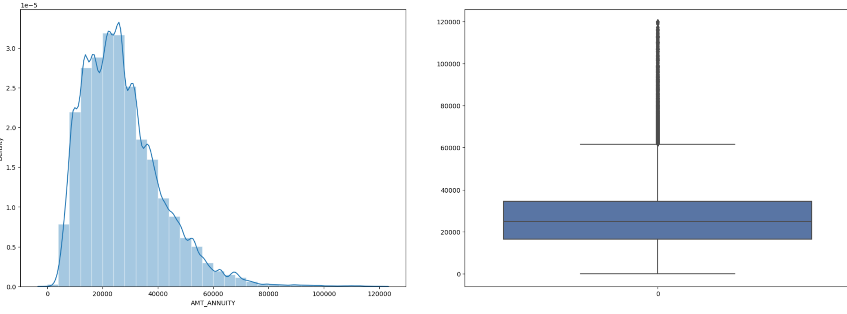
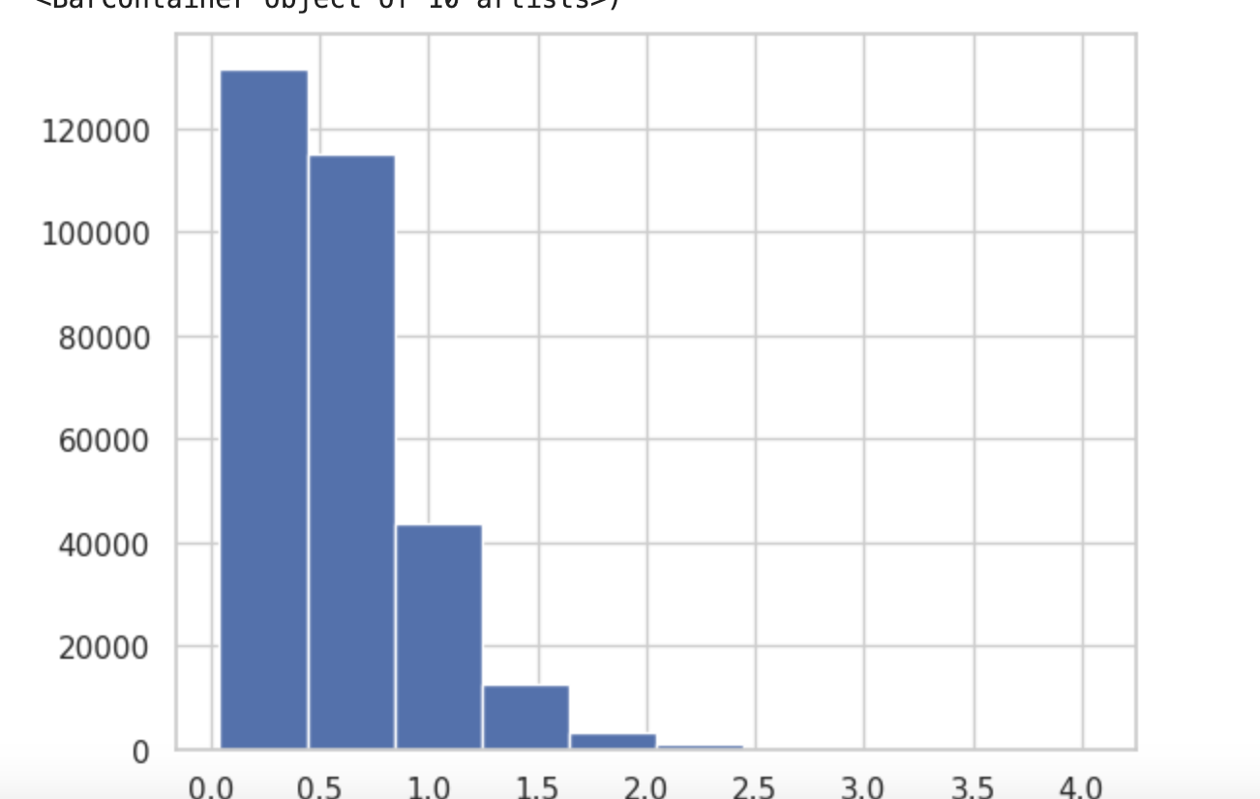

Slide 5
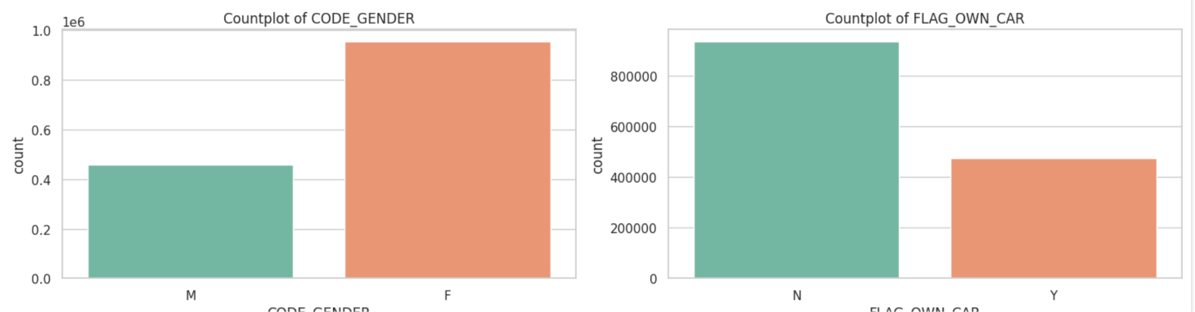
Univariate Analysis
Univariate analysis in the context of this loan data involves examining each variable independently to understand its characteristics, distribution, and potential influence on loan default rates. This analysis was very crucial for gaining an initial understanding of the data before delving into more complex multivariate analyses.

Slide 6
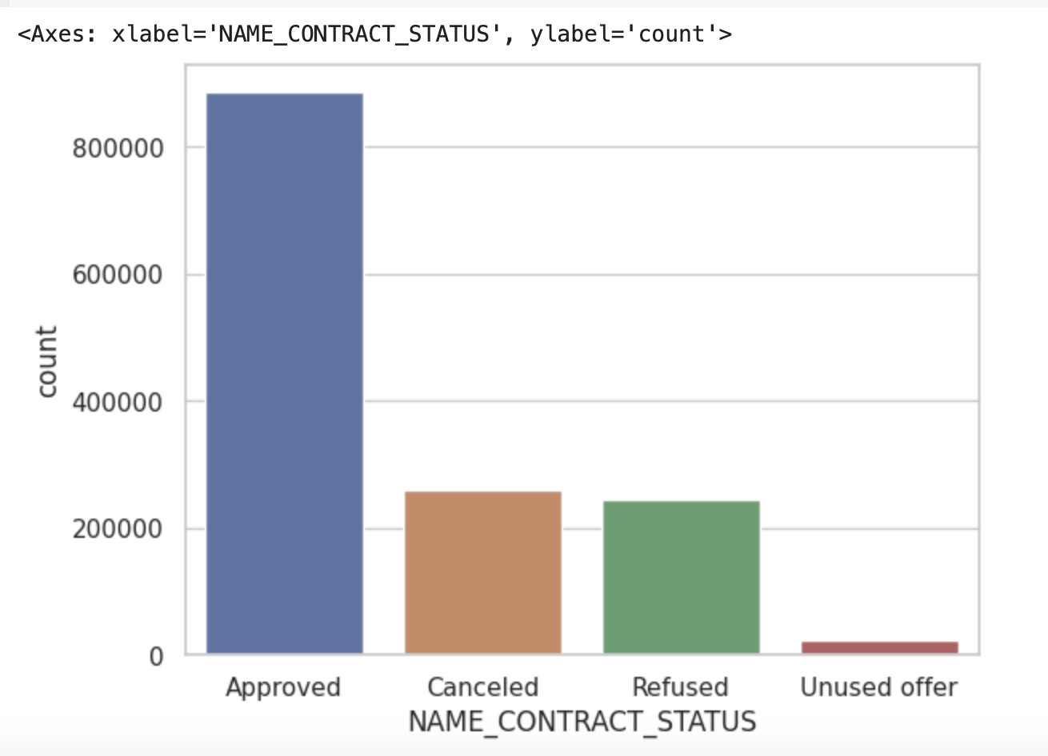
Univariate Analysis

Slide 7
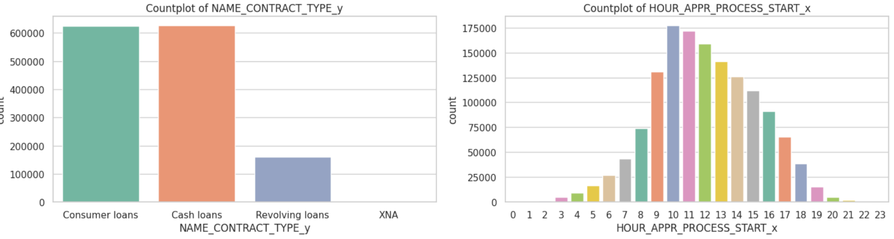
Univariate Analysis

Slide 8
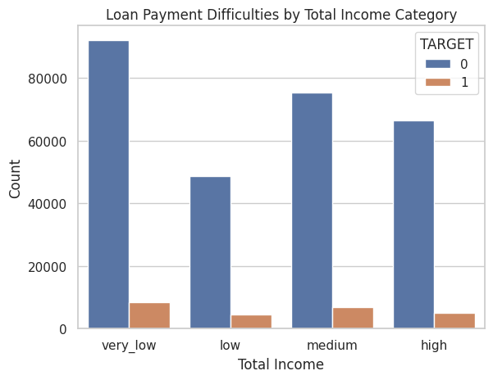
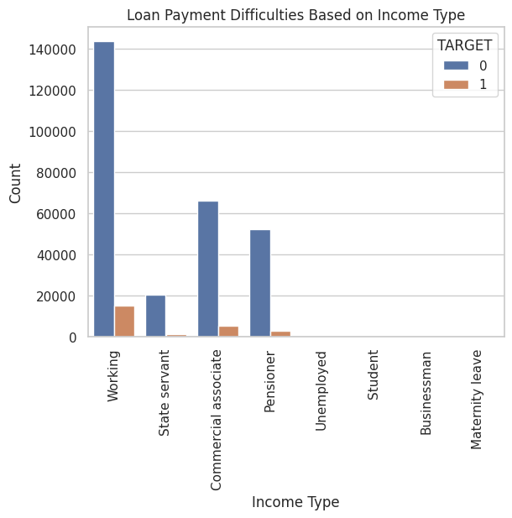
Income Analysis
Different income categories (very_low, low, medium, high) were analyzed. It was observed that clients with very low income and working a job are more likely to default on loans.

Slide 9
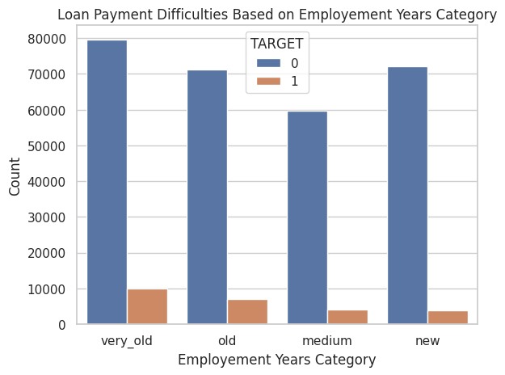
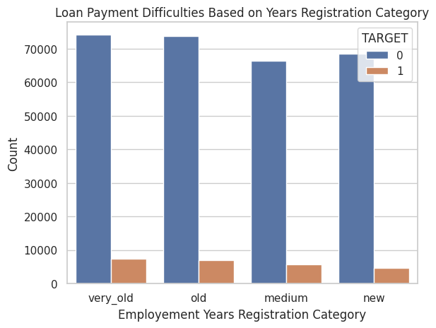
Employment Years
Longer employment history correlated with a higher likelihood of loan defaults.

Slide 10
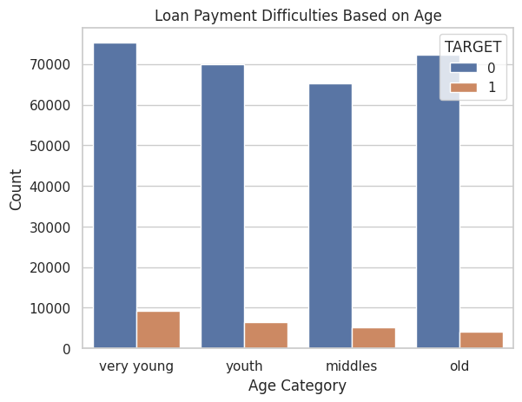
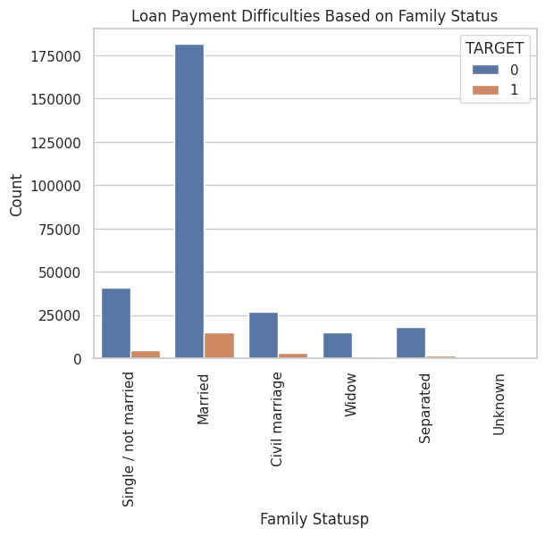
Age Analysis
Also clients who are married are more likely to be defaulters, followed by clients who are single and who had civil marriages .
Younger clients were found to be more likely to default.

Slide 11
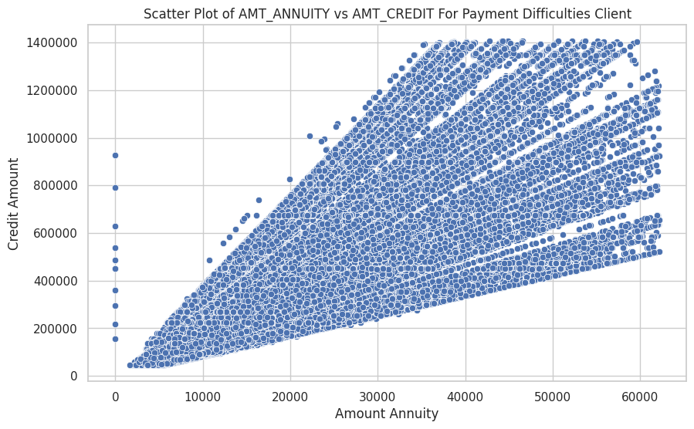
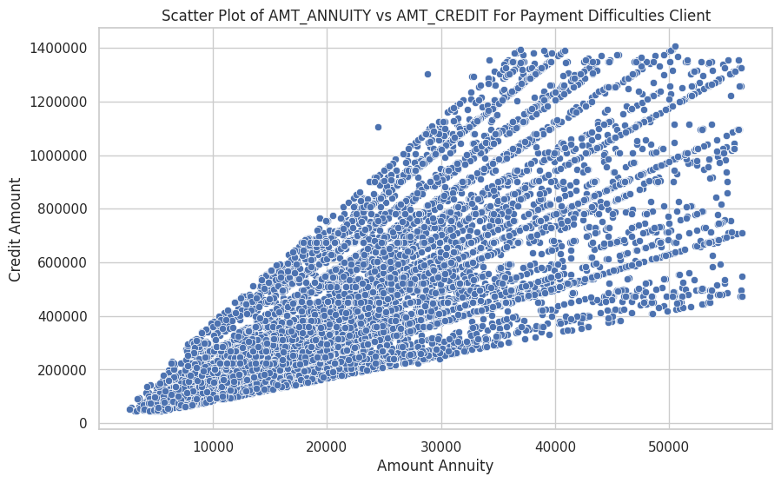
Credit Amount Analysis
Analysis for credit amount categories showed that clients with low credit amounts are more prone to default. Similarly, loan annuity amounts also correlate with default rates.

Slide 12
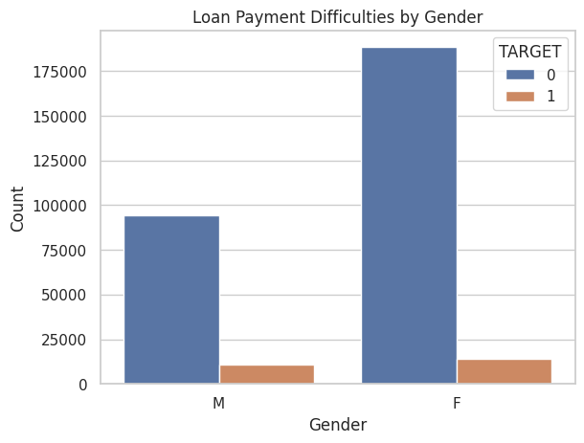
Gender Analysis
The count plot of CODE_GENDER against the TARGET variable revealed interesting insight that females were more likely to default on loans compared to men.

Slide 13
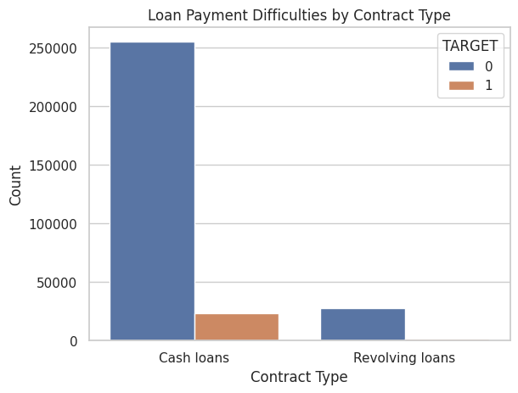
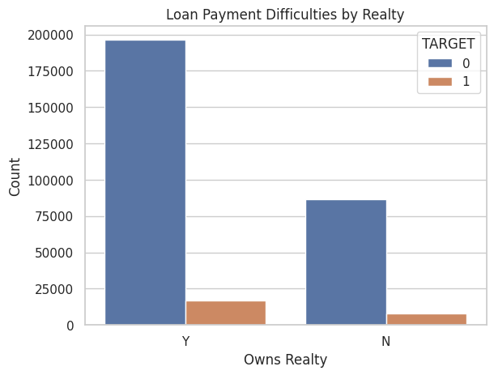
Contract Type
Most contracts were of type 'Cash Loans', with a small margin where such clients tended to default more compared to 'Revolving Loans'.
Clients who own Realty are more likely to not pay loan compared to those who do not own one.

Slide 14
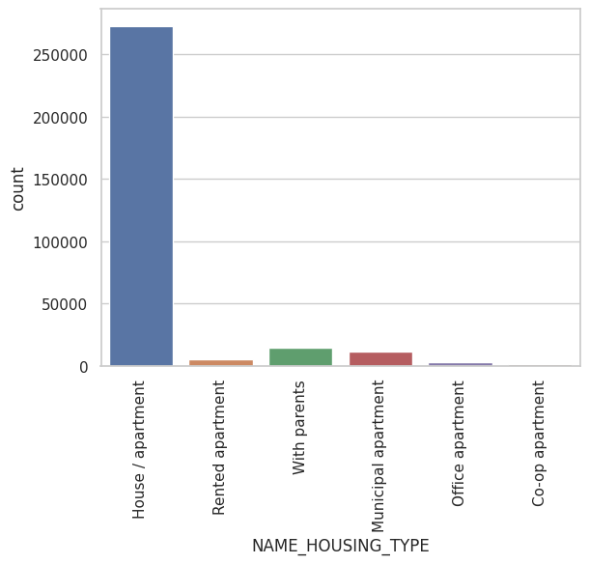
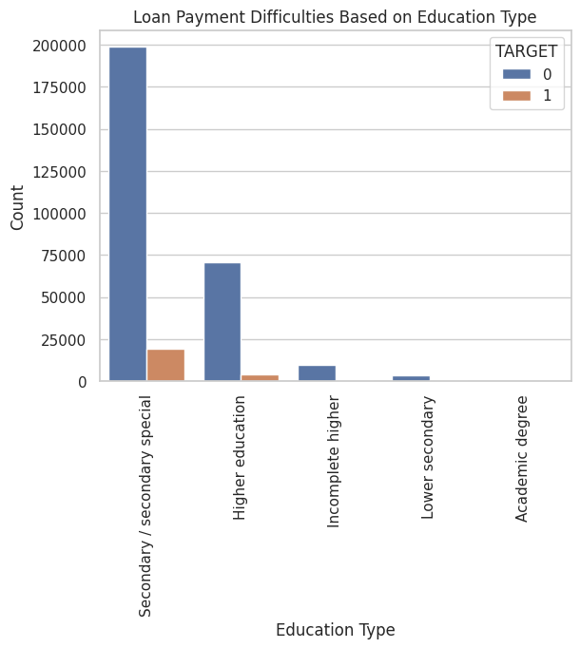
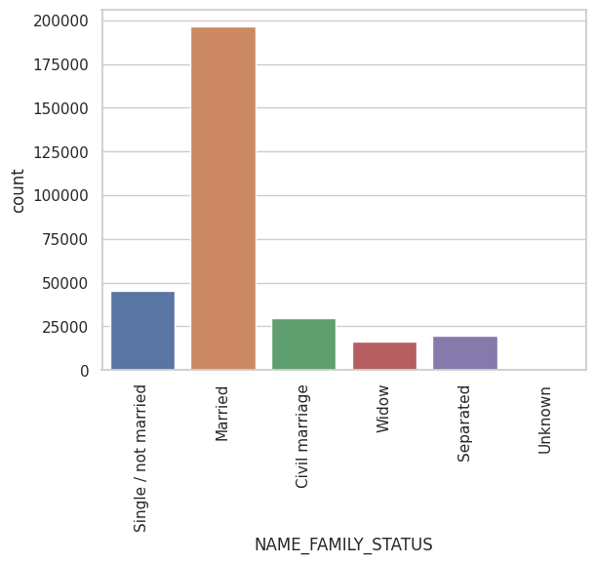
Bivariate Analysis
A detailed bivariate analysis was conducted to understand the relationship between various features and the target variable (loan default).
Features like NAME_HOUSING_TYPE, NAME_FAMILY_STATUS, NAME_INCOME_TYPE, NAME_EDUCATION_TYPE, and others were analyzed against the target variable to understand patterns in loan defaults.

Slide 15
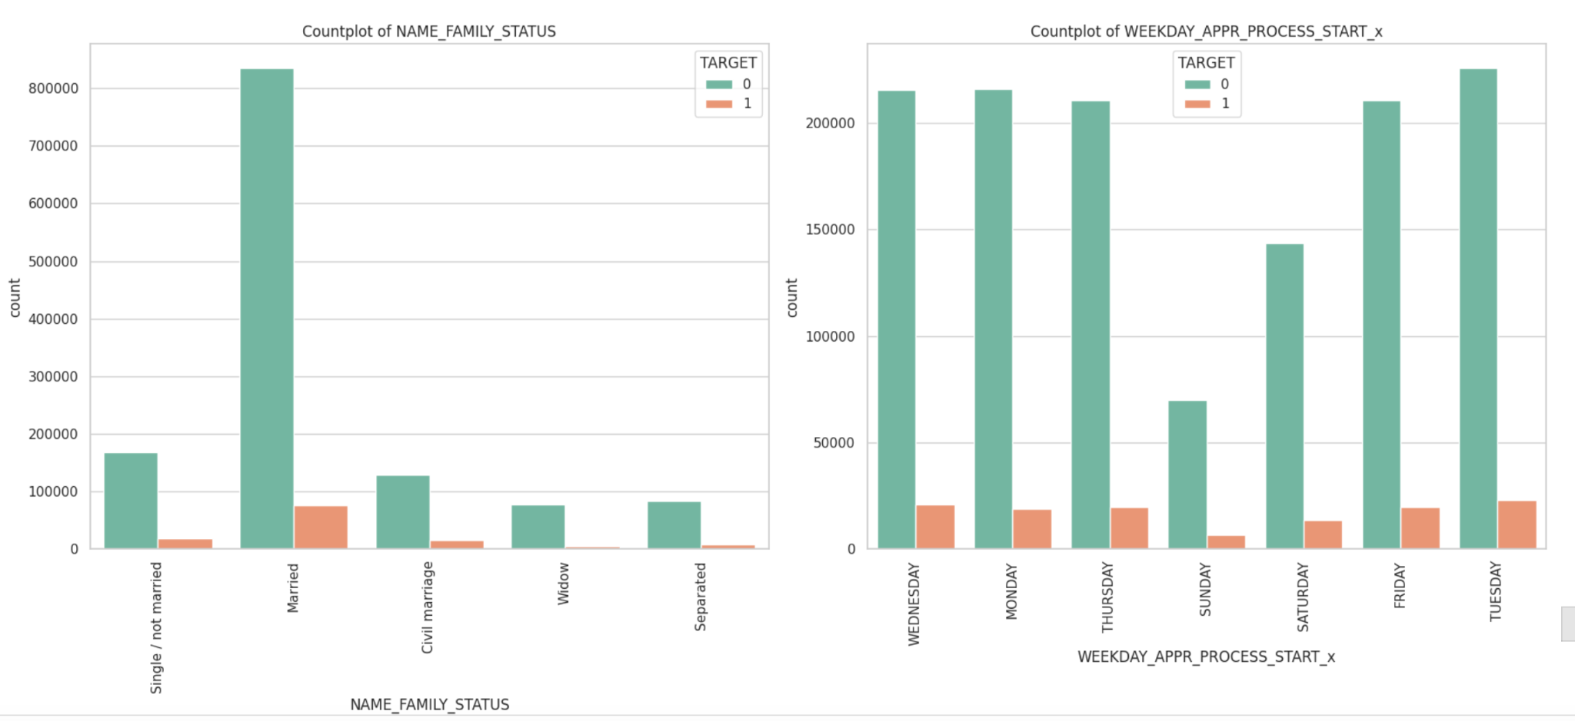
Bivariate /Multivariate Analysis

Slide 16
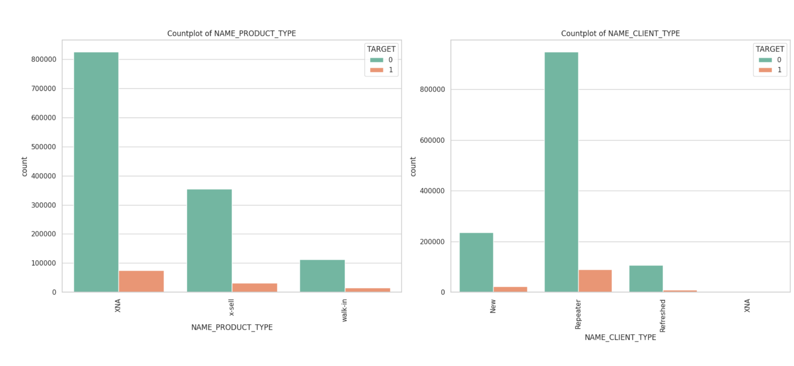
Bivariate /Multivariate Analysis

Slide 17
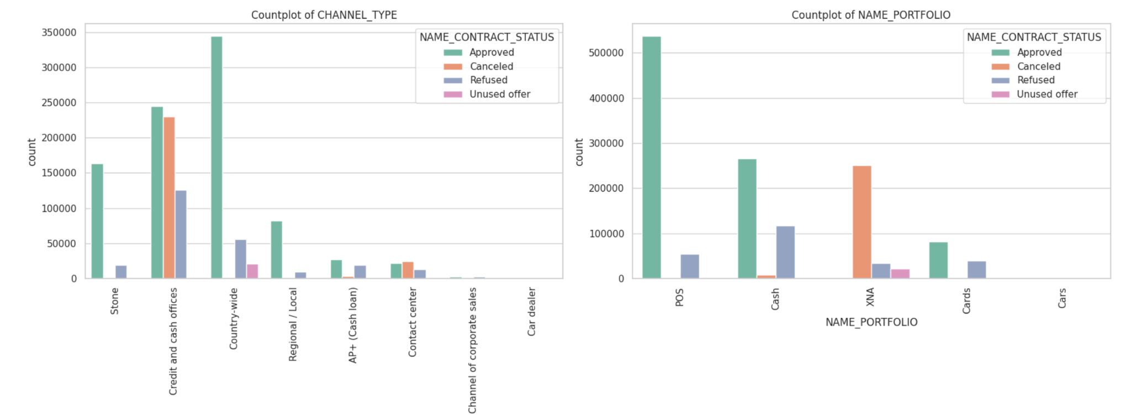
Bivariate /Multivariate Analysis

Slide 18
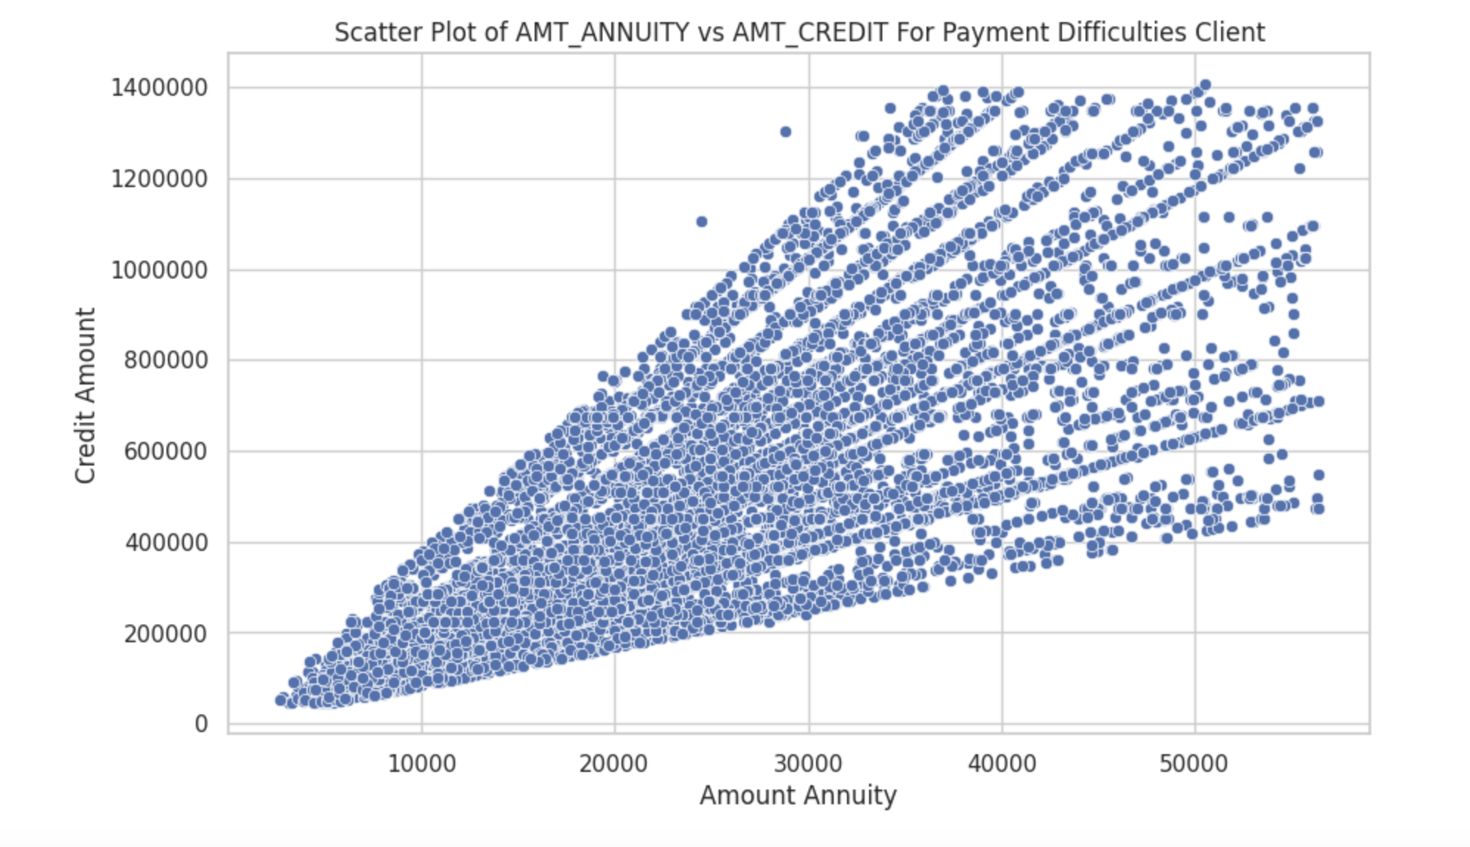
Bivariate /Multivariate Analysis
Using Scatter plots for numerical data

Slide 19
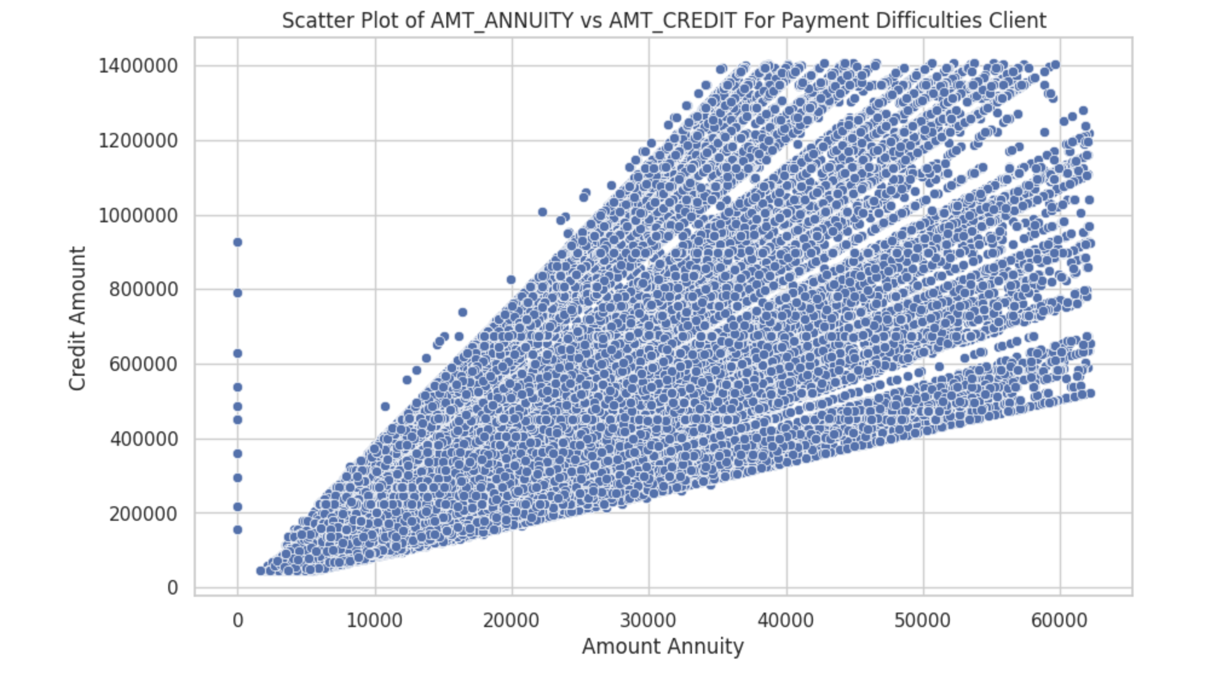
Bivariate /Multivariate Analysis
AMT_CREDITand AMT_ANNUITY have strong positive correlation. As a result Annuity Amount increases, so does Credit Amount.
AMT_CREDIT and AMT_GOODS_PRICE have a robust positive association. In other words, the Credit Amount grows together with the price of the goods.

Slide 20
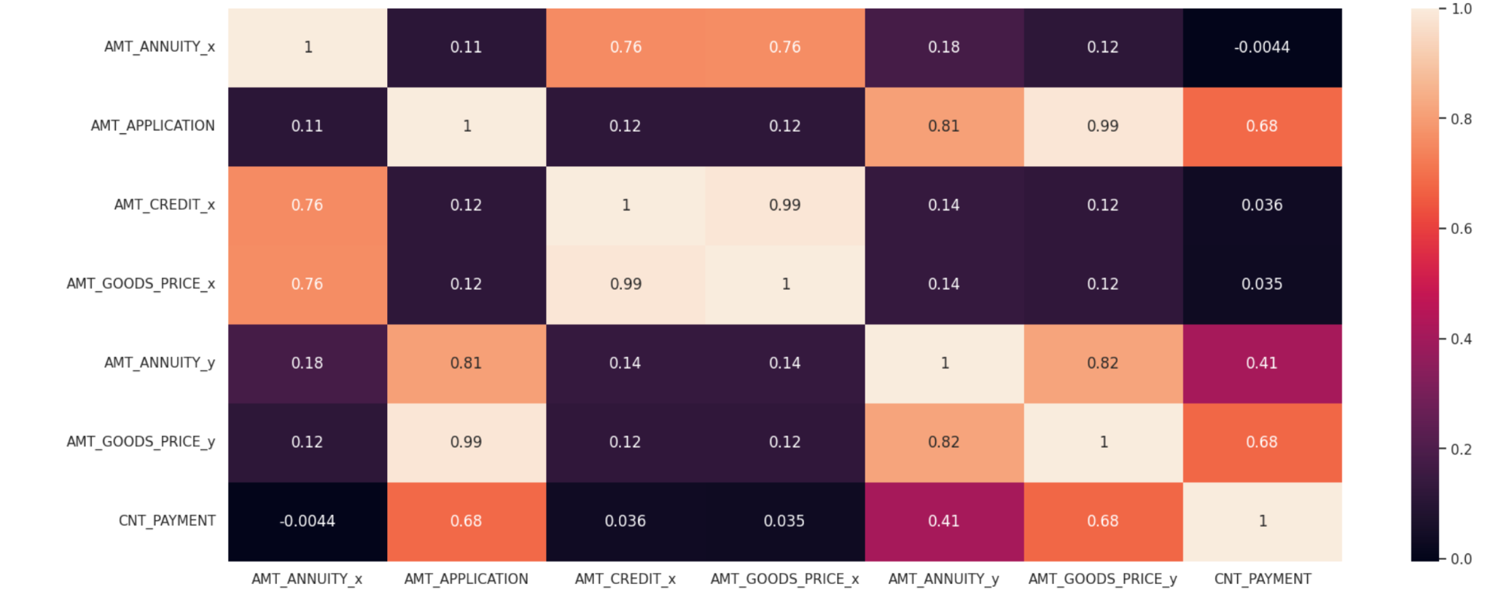
Correlation Analysis

Slide 21
Correlation Analysis
Observations
AMT_APPLICATION demonstrates a strong correlation with AMT_ANNUITY_y,AMT_GOODS_PRICE_y
AMT_GOODS_PRICE_y is strongly correlated with AMT_ANNUITY_y, AMT_CREDIT_y, and AMT_APPLICATION, and shows a considerable correlation with CNT_PAYMENT.
AMT_CREDIT_y exhibits a strong correlation with AMT_GOODS_PRICE_y and a considerable correlation with CNT_PAYMENT.
AMT_ANNUITY_x is highly correlated with both AMT_GOODS_PRICE_y and AMT_CREDIT_y.
Additionally, AMT_ANNUITY_x has a strong correlation with AMT_GOODS_PRICE_x and AMT_CREDIT_x.
Finally, AMT_CREDIT_x is strongly correlated with AMT_GOODS_PRICE_x.

Slide 22
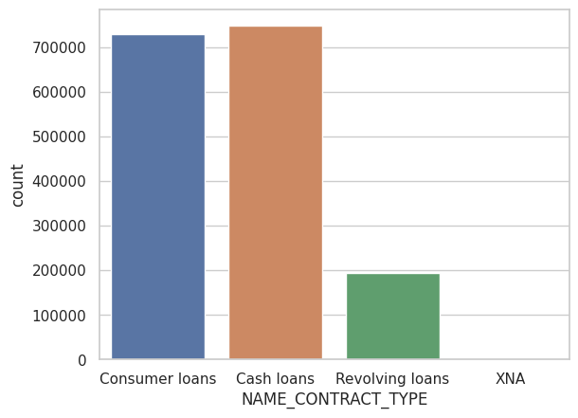
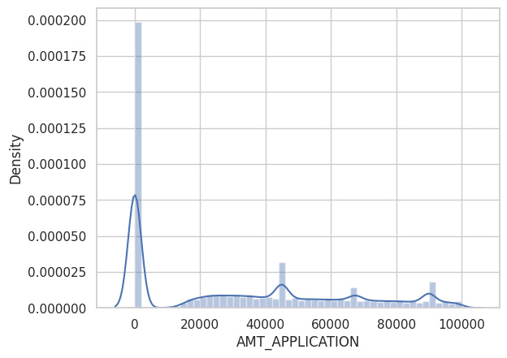
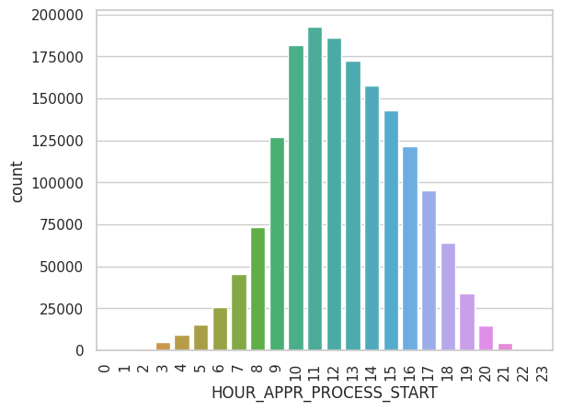
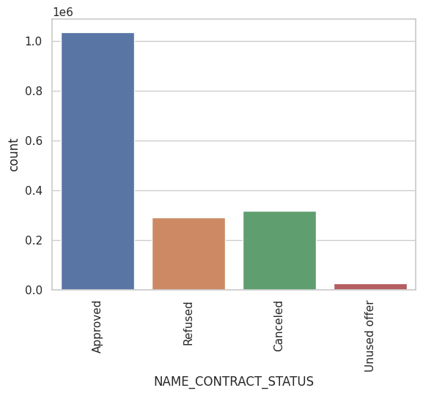
Additional Analysis on Previous Applications
A separate dataset on previous loan applications was analyzed for patterns and missing values were treated accordingly.
Key insights included the types of products, contract status, and client characteristics in previous loan applications and their outcomes.

Slide 23
Observations & Conclusions
The analysis concluded several key insights, such as higher default rates in females, younger clients, clients with shorter employment history, and clients with low income or low credit amounts.
It was also noted that certain types of clients (like those living in apartments or those with a working income type) are more likely to default on loans.

Slide 24
Key Takeaways
Gender and Default Risk:
Females are more likely to be defaulters.
Contract Type and Default Behaviour:
Majority are Cash Loans; clients with cash loans tend to be defaulters to a small extent.
Clients with revolving loans show almost no default behaviour.
Realty Ownership and Loan Payment:
Clients who own realty are more likely to default compared to those who don't.
A large portion of clients own realty, which might bias this conclusion.

Slide 25
Key Takeaways
Income Level and Default Likelihood:
Very low income clients are most likely to default, followed by medium, low, and high income ranges. Goods Price and Default Tendency:
Clients purchasing low-price goods are most likely to default, followed by very low, medium, and high price ranges.
Employment History and Defaulting:
Longer employment history correlates with a higher likelihood of defaulting; newer employees have a lower default rate.
Age and Default Rates:
Younger clients are more likely to default, with the rate decreasing as age increases.

Slide 26
Key Takeaways
Car Ownership and Defaulting:
Clients who own a car are less likely to default.
Housing Type and Defaulting:
Apartment dwellers are more likely to default, followed by those living with parents.
Marital Status and Defaulting:
Married clients are more likely to default, followed by single clients and those in civil marriages.

Slide 27
Key Takeaways
Income Type and Defaulting:
Working clients are most likely to default, followed by commercial associates, pensioners, and state servants.
Education Level and Defaulting:
Secondary education holders are more likely to default, followed by those with higher education.
Organization Type and Defaulting:
Clients from Business Entity Type 3, Self-employed, XNA, and other types are more prone to defaulting.

Slide 28
Key Takeaways
Occupation Type and Defaulting:
Unidentified occupations have the highest default rate, followed by laborers, sales staff, drivers, core staff, and managers. Other occupations contribute * less to default rates.
Client History and Defaulting:
Repeat clients are more likely to default compared to new and refreshed clients.
X-Sell products are commonly purchased by defaulting clients.
Family Size and Defaulting:
Clients with no children have the highest default rate, decreasing with more children.

Slide 29
Key Takeaways
Previous Loan Purpose and Defaulting:
Previous applications for POS have a higher default rate, followed by cash, XNA, and cards.
Document Submission and Defaulting:
Clients who don't submit all documents tend to default.
Application Dates and Defaulting:
Tuesdays and Wednesdays see most defaults, with weekends having fewer due to fewer applications.

Slide 30
Overall Conclusion
The analysis provided valuable insights into factors affecting loan defaults. It highlights the importance of considering a client's income, credit amount, employment history, age, and gender when assessing loan applications. These findings can be instrumental for financial institutions in making informed decisions regarding loan approvals and risk management.

Slide 31
Thank you for your time 😊

